Slide 1
Newton’s Principia
Max Ducey and John Kim

Slide 2
Agenda
Newton’s Life
Philosophy of Science
Newton’s Principia
Laws of Motion

Slide 3
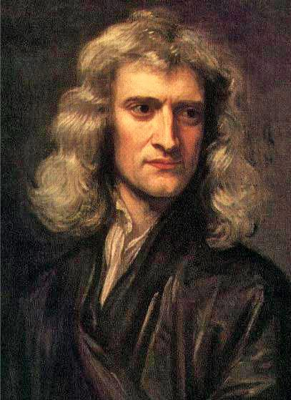
Isaac Newton
Woolsthorpe, 1642
Farming village
Father ilterate, mother semi-literate
Raised by grandmother
Failure as a farmer
Boarding school - King’s School in Grantham

Slide 4
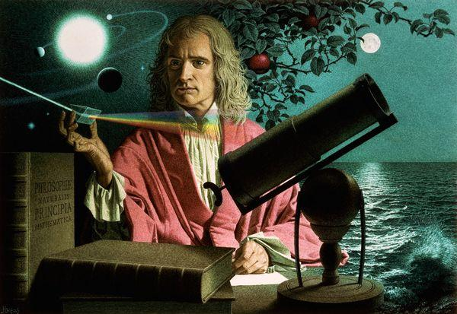
Isaac Newton
Enrolled at Trinity College 1661
1664-1665
Develop calculus
Lines generated by continuous motion
Time as independent variable

Slide 5
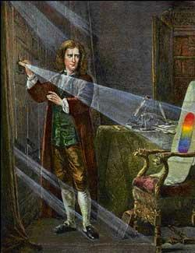
Isaac Newton
1665-1667
annus mirabilis
Experiments in chemistry
Light experiments with prism
Invent calculus
Consider forces necessary to keep moon in orbit
Notes:
Consider forces necessary to keep moon in orbit - foundation for mechanics and gravitation

Slide 6
Isaac Newton
Lucasian Professor of mathematics at 26 at Trinity College in 1669
Enemies with Robert Hooke a senior member of the Royal Society of London
Enraged by public criticism withdrew into isolation from 1678-1684
Focus on Hermetic tradition and alchemy during this time

Slide 7
Isaac Newton
Worked on math, theology, and alchemy to reinstate new religion to defeat atheism
Unitarian
Bible conspiracy
Didn’t take Holy Orders for Fellowship at Cambridge

Slide 8
Isaac Newton
Warden of the Mint 1696
Promoted to Master of the Mint
Worked enthusiastically at this cushy job

Slide 9
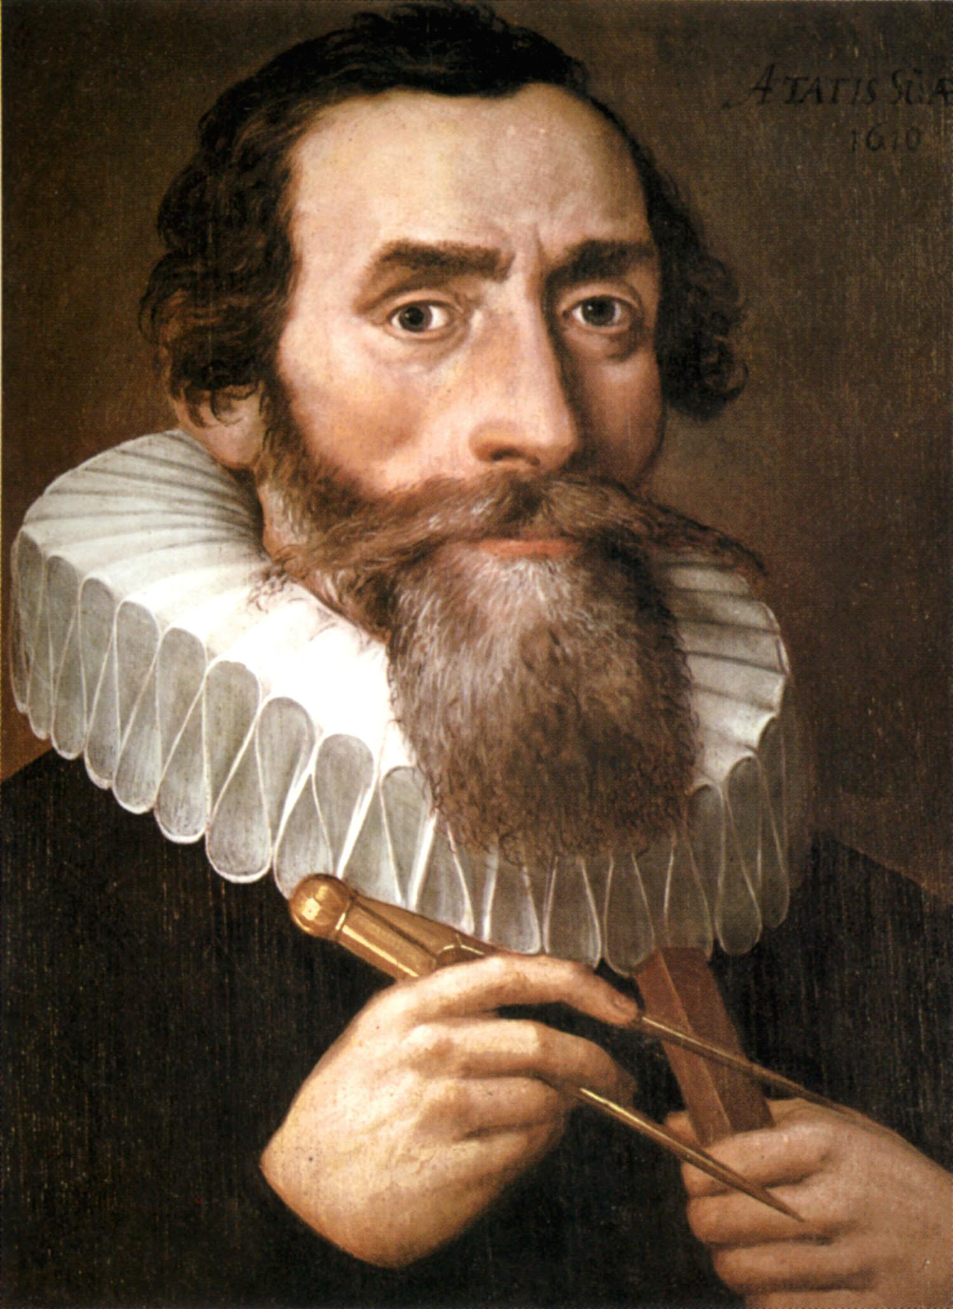
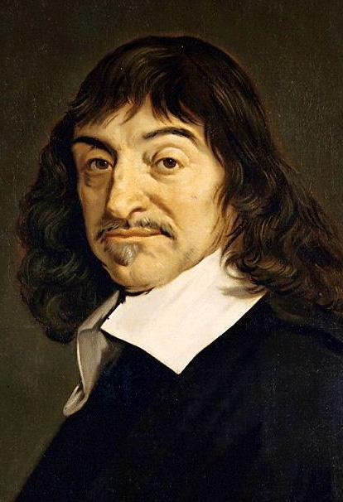
Influences
Amicus Plato amicus Aristoteles magis amica veritas

Slide 10
How was Newton able to come up with his revolutionary theories when almost everyone was still viewing the world through Aristotelian mechanics?

Slide 11
Agenda
Newton’s Life
Philosophy of Science
Newton’s Principia
Laws of Motion

Slide 12
Philosophy of Science
Induction-not enumerative (Cushing)
Bacon (pure induction)
collect as much evidence as possible and look for trends
Newton
More deductive, more certain
Minimal experimentation
New paradigm
Notes:
Newton adopted a different approach to science than Bacon.

Slide 13
3 Levels
Mathematical
Physical
Philosophical

Slide 14
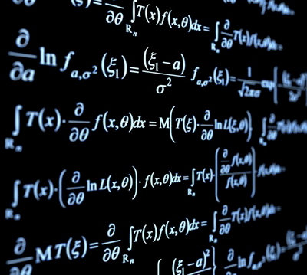
Mathematical
Deductive
Analytical
Start with axioms and use logic for further knowledge
What follows from a set of axioms?

Slide 15
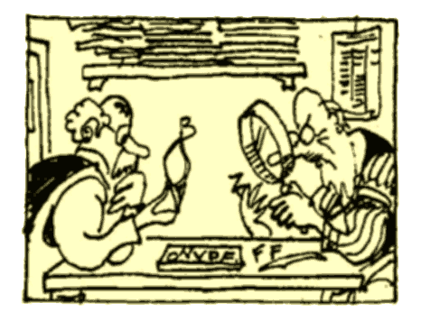
Physical
Empirical
How does it map to nature?
Compare mathematical model with sensory experience data

Slide 16
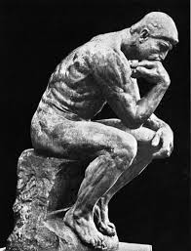
Philosophical
Search for cause of laws
Where does model come from?
Newton was never able to explain where the laws of gravitation came from.

Slide 17
Should we be satisfied with not knowing the origin of gravity? Should we take his theories less seriously because of this?
Notes:
How does gravity work? Where did it originate? Should we be satisfied with not knowing?
Is the aim of science merely to create a model that fits best with the data, or to explain the nature of reality (Instrumentalism vs. realism). Should we merely induce laws from what we observe in nature?
“Hypotheses non fingo”. Whatever is not deduced from phenomena is called hypothesis (speculation). Speculation has no place in experimental philosophy.

Slide 18
Macrocosm and Microcosm
Macrocosm
World of sensory experience
Explained in terms of a microcosm which is unsensible
Microcosm
Unsensible world (forces, gravity)
Induce microcosm from sensible world
Explains causes of natural world
Notes:
The microcosm was Newton’s approach to explaining the philosophical level. The laws of motions and universal gravitation cover the mathematical and physical

Slide 19
Rules of Reasoning in Philosophy
Beginning of Book 3 of Principia
Rule I: Use the fewest number of causes required
Rule II: Explain different phenomenon with same cause
Rule III: Qualities common to all bodies are universal
Rule IV: Induced theories are true until refuted
Notes:
Rule I: Don’t add extra causes if fewer causes will explain with same sufficiency (simplicity)
Rule II: Example, explain moon orbiting earth and apple falling to earth with same cause (force)
Rule III: If all bodies observed have mass, assume this is a universal quality

Slide 20
Is it wise to think nature operates in the simplest way? Why should we think this?
Notes:
The Principle of Simplicity does a lot of work for Newton in his theories. Is this wise? Malbranche and Leibniz would claim this makes sense because God acts according to the simplest means.

Slide 21
Agenda
Newton’s Life
Philosophy of Science
Newton’s Principia
Laws of Motion

Slide 22
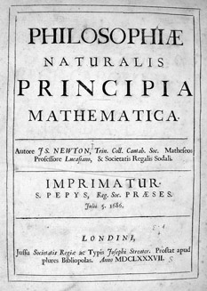
The Principia
A work in 3 books
Began as a conversation about deriving Kepler’s laws from physical forces (Hooke, Wren, Halley)
Wren offers prize: prove Kepler with inverse square law
Initially published as a single book to answer this problem
Notes:
Kepler’s laws were induced from natural phenomena. By observing the paths of celestial objects. But there was nothing to explain them. No natural motion qua Aristotle.

Slide 23
Is it unscientific for Newton to set out to prove Kepler’s Laws? Is that not a biased starting point?

Slide 24
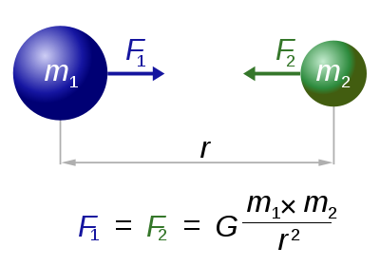
Universal Law of Gravitation
Notes:
Answer to wren’s challenge

Slide 25
Universal Law of Gravitation
Force between moon and Earth is same force that keeps objects stationary on earth and falling to earth (rule II)
Universal
No ad hoc assumptions like Kepler
2 Force sun, strange magnetism for sun
Notes:
Kepler’s theory had one magnetism for sunn and one magnetism for earth. Newton’s theory applied everywhere, so esily testable (on earth)

Slide 26
How does Newton account for the fact that gravitation is a force that acts on a distance? Does this not make gravity an invisible force?

Slide 27
The Principia
Favored Geometry instead of algebra
Visual and divine
Fluxions and time as independent
Notes:
Newton opted to use a geometric approach to prove things, similar to the ancient greeks, even thouhg he could have used his version of calculus “fluxions” in an algebraic form. Geometry was visual and thus better represented reality. It’s absolute truth also reflects the divine. Algebra is obaque and disconnected

Slide 28
Definitions of Mechanistic Systems
Mass
Momentum
Force

Slide 29
Mass
Newton: “The quantity of matter is the measure of the same, arising from its density and bulk conjointly.”
Contemporary: Intrinsic property of the body, matter in the body

Slide 30
What is the fundamental flaw in Newton’s definition of mass?
Notes:
Circular argument. Mass = Density x Volume. However, density = Mass/Volume.

Slide 31
Momentum
Newton: “The quantity of motion is the measure of the same, arising from the velocity and quantity of matter conjointly.”
Contemporary: Mass x Velocity

Slide 32
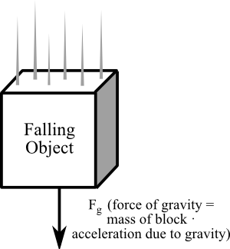
Force
Newton: “The change of motion is proportional to the motive force impressed; and is made in the direction of the right line in which that force acts”
Contemporary: Force = Mass x Acceleration

Slide 33
Agenda
Newton’s Life
Philosophy of Science
Newton’s Principia
Laws of Motion

Slide 34
Counter-Intuitive Laws?
How was Newton able to come up with his revolutionary theories?
Counter-intuitive laws

Slide 35
Laws of Motion
1st Law of Motion
Law of Inertia
Notes:
Newton did not use equations in his work. Instead he used proportions, the prevailing method of the time

Slide 36
Laws of Motion
2nd Law of Motion
F=ma
Change in motion proportional to force impressed
F=dp/dt
Notes:
Newton did not use equations in his work. Instead he used proportions, the prevailing method of the time

Slide 37
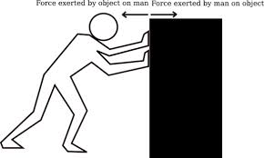
Laws of Motion
3rd Law of Motion
Equal and opposite reactions
Notes:
Newton did not use equations in his work. Instead he used proportions, the prevailing method of the time

Slide 38
Scholium
Absolute Space
“Absolute space, in its own nature, without relation to anything external, remains always similar and immovable.”
Absolute Time
“Absolute, true, and mathematical time, of itself, and from its own nature, flows equably without relation to anything external, and by another name is called duration”
Contrast with Relativity Theory

Slide 39
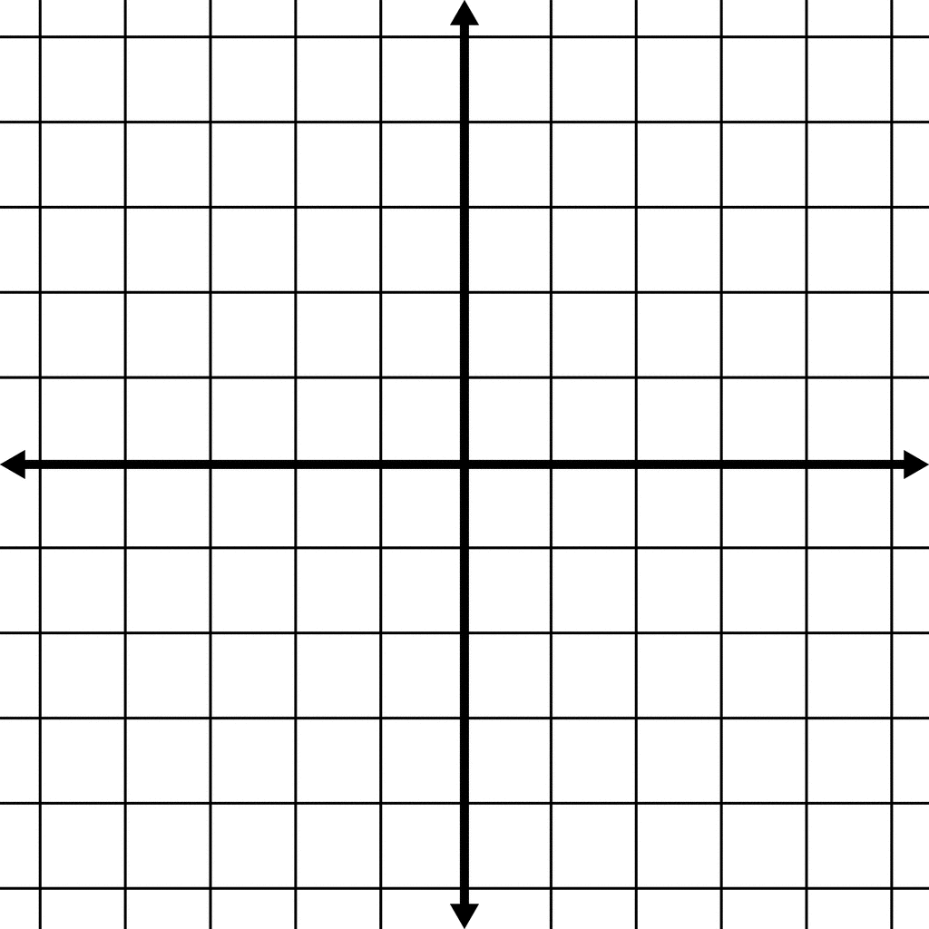
Absolutist vs. Relativist
Can space exist without things to fill it?
Can time exist without events occurring?
Fundamentally the same (Mach, Leibniz)
Fundamentally different (Newton)

Slide 40
Absolutist vs. Relativist
Bucket Example
Is a reference point outside the bucket needed to make sense of rotation?
Is the concavity enough?

Slide 41
What prevented Newton from establishing a framework that modeled all of mechanics with 100% accuracy?
Notes:
Newton believed in an absolute space and time. His rigid assumptions about space and time did not allow for a 100% accurate working theory of gravity. Philosophers of science like Einstein were able to develop more accurate models of gravity by paying closer attention to space and time in relativity theory.

Slide 42
Limits of Newtonian Mechanics
Fails at speeds near the speed of light
Fails at the quantum level

